Slide 1
Edema from MRI
A comprehensive way
Moo Yewtsing
2018.08.26

Slide 2
Material
T2-flair DICOM images from 66 patients before and after their first therapy
These patients' physiological records before the first therapy

Slide 3
Method
Resize images to 320 * 320, record changes in Spacing
Segment edema areas via OpenCV (Bradski, Gary, and Adrian Kaehler. Learning OpenCV: Computer vision with the OpenCV library. " O'Reilly Media, Inc.", 2008.)
Calculate volume changes, quantify features via PyRadiomics (van Griethuysen, Joost JM, et al. "Computational radiomics system to decode the radiographic phenotype." Cancer research 77.21 (2017): e104-e107.)
Select features related to “Shape”, "ASM", "Contrast", "Correlation", "Homogeneity", "Entropy", "Variance", "Skewness", "Kurtosis" by T-test. (Aggarwal, N. and Agrawal, R.K. (2012) First and Second Order Statistics Features for Classification of Magnetic Resonance Brain Images, Journal of Signal & Information Processing, 3, 146-153.)

Slide 4
(for bilateral)
Select samples whose both unilateral cerebral edema volumes before therapy are larger than 2000 mm³
Computer the Euclidean distances of parts in these bilaterals after Standardisation and Weights adjustification
Find possible relationship between features and different outcomes in right & left part by T-test

Slide 5
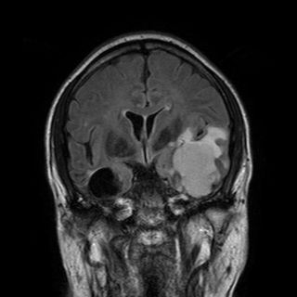
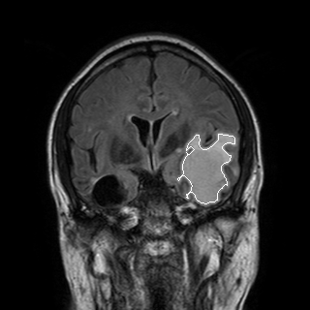
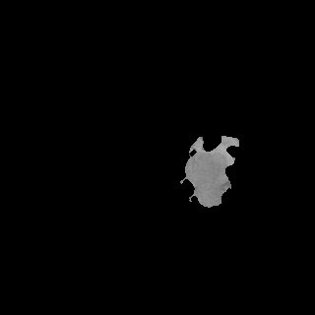
Example of Segmentation

Slide 6
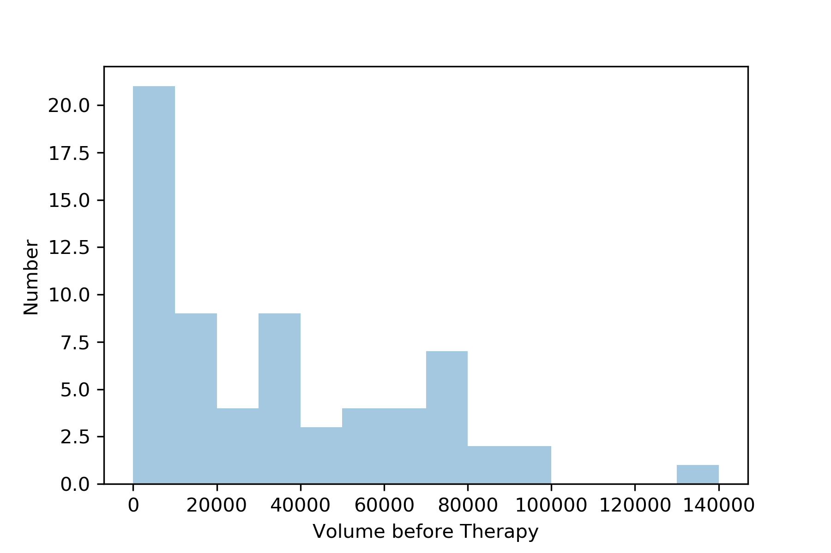
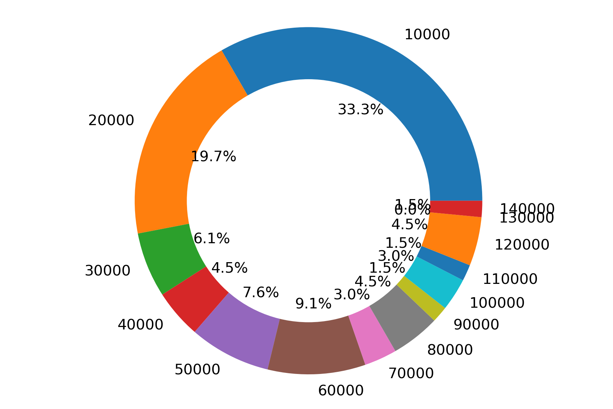
Data Profile

Slide 7
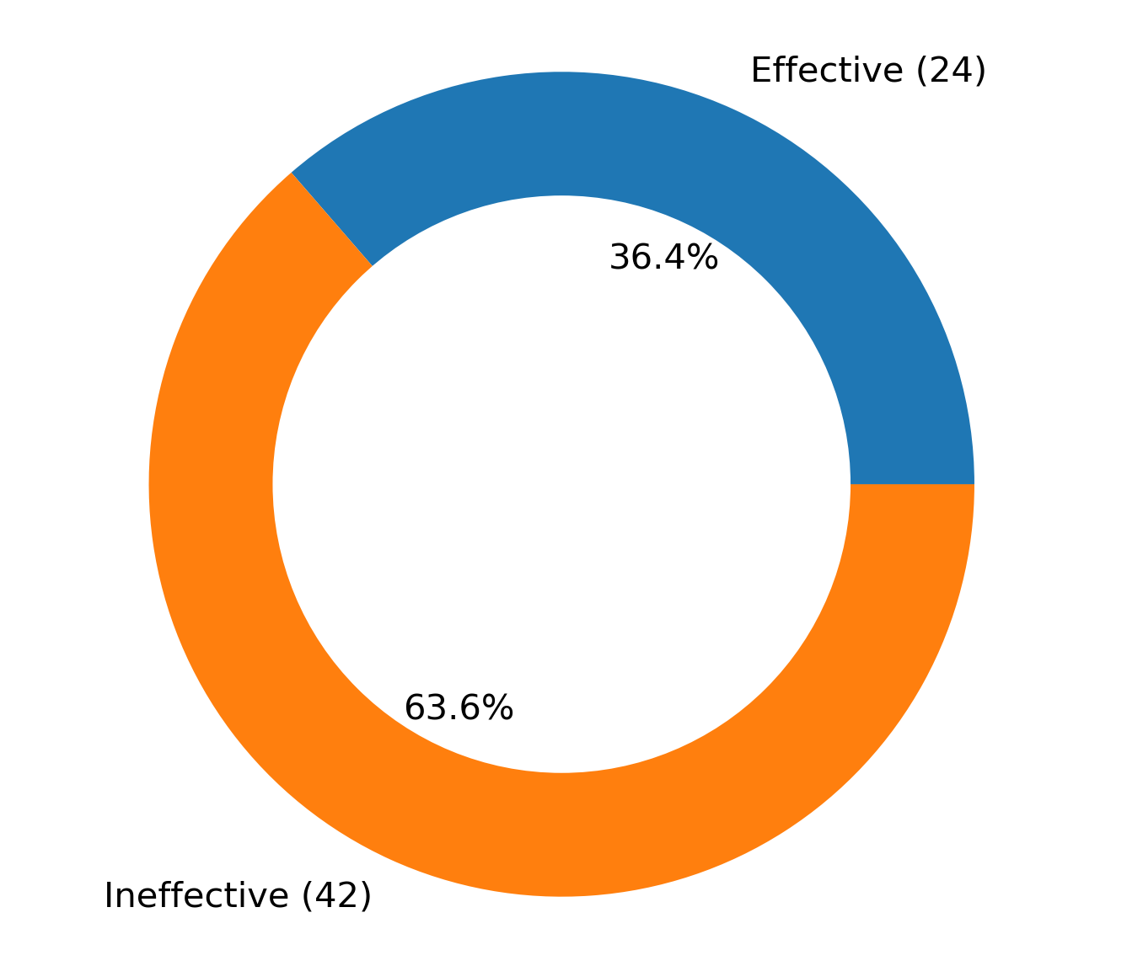
The effect of the therapy is defined by whether the volume of cerebral edema reduce to less than 75% of its previous volume that is before one course of treatment.

Slide 8
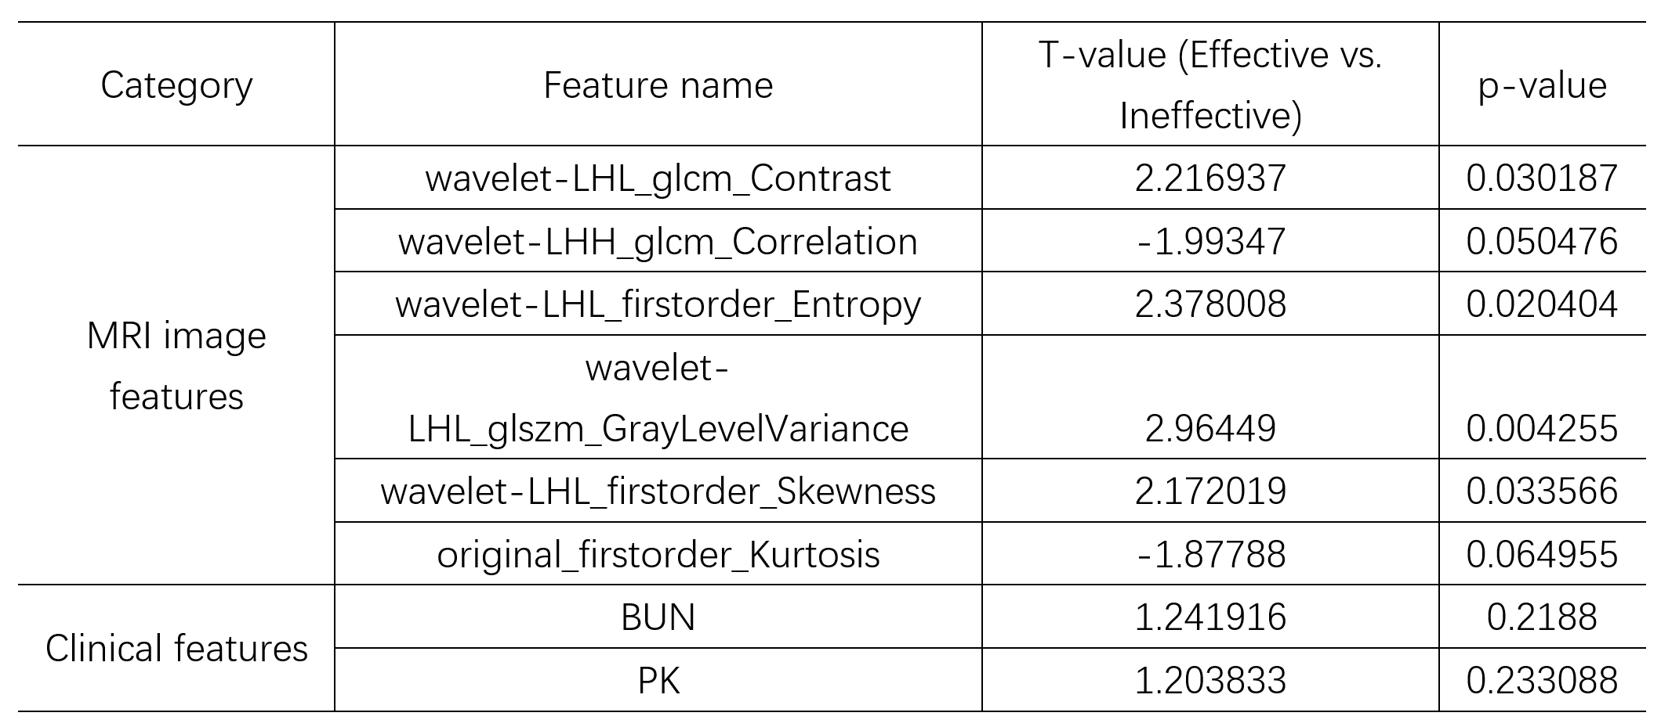
Result 1

Slide 9
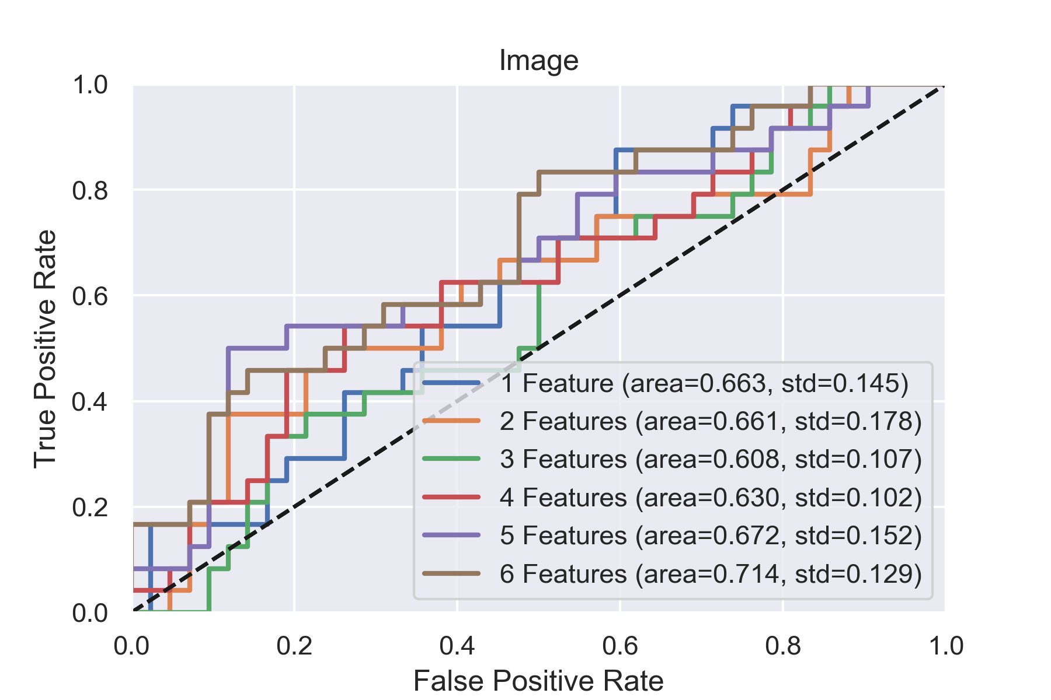

Slide 10
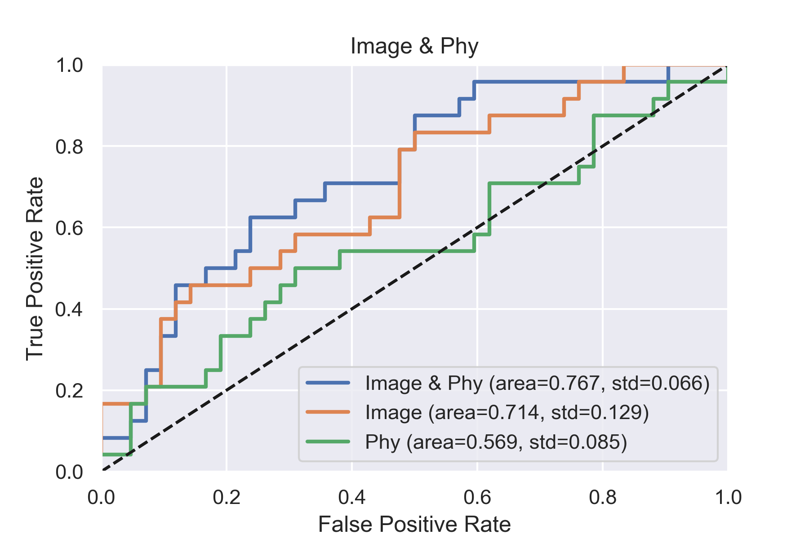
Cross Validation = 5

Slide 11
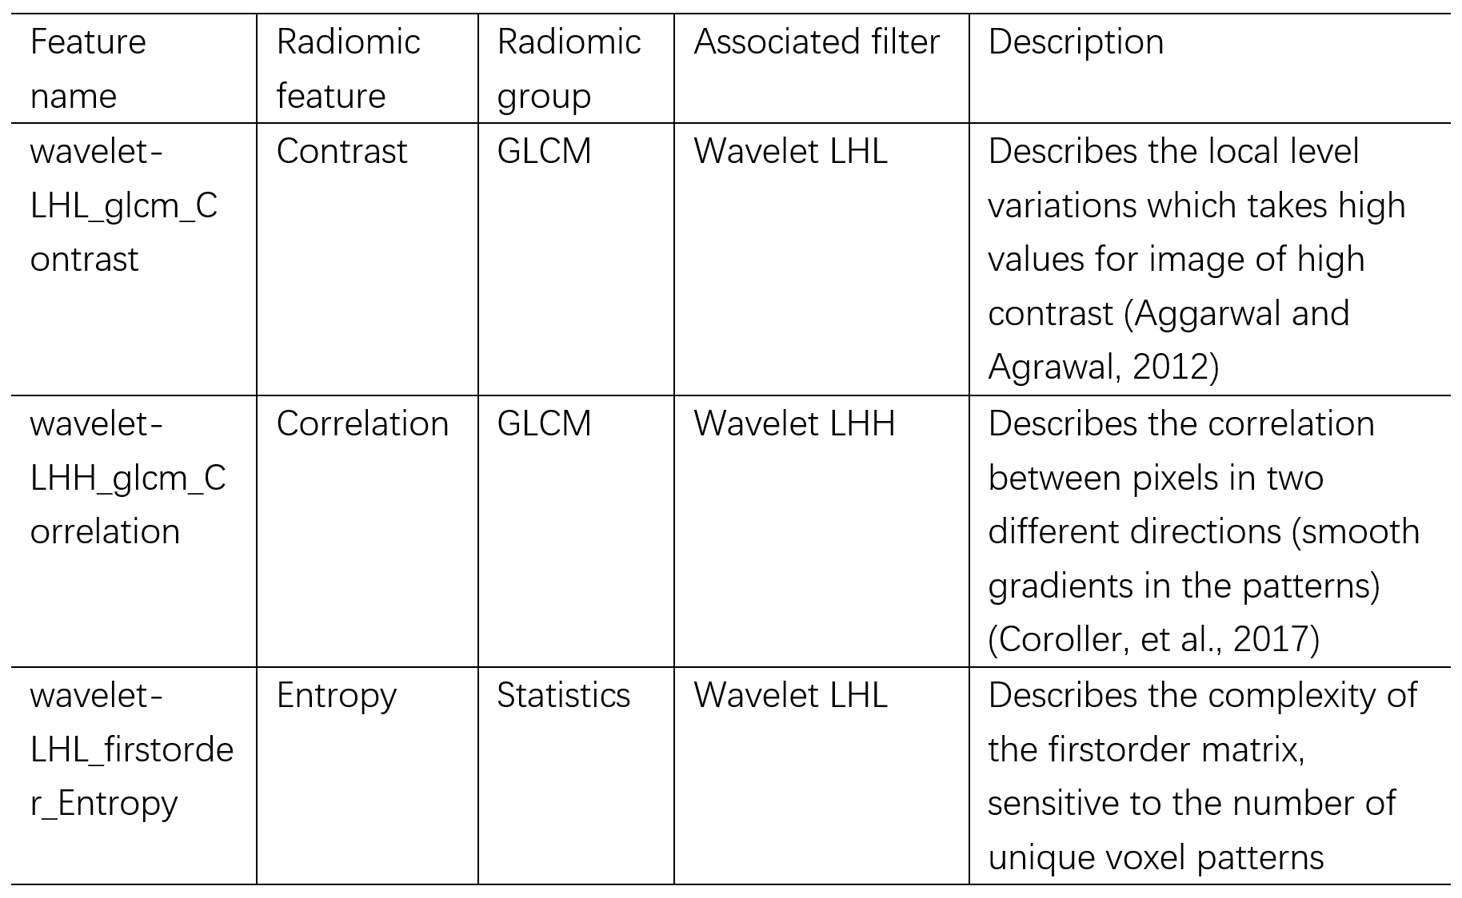

Slide 12
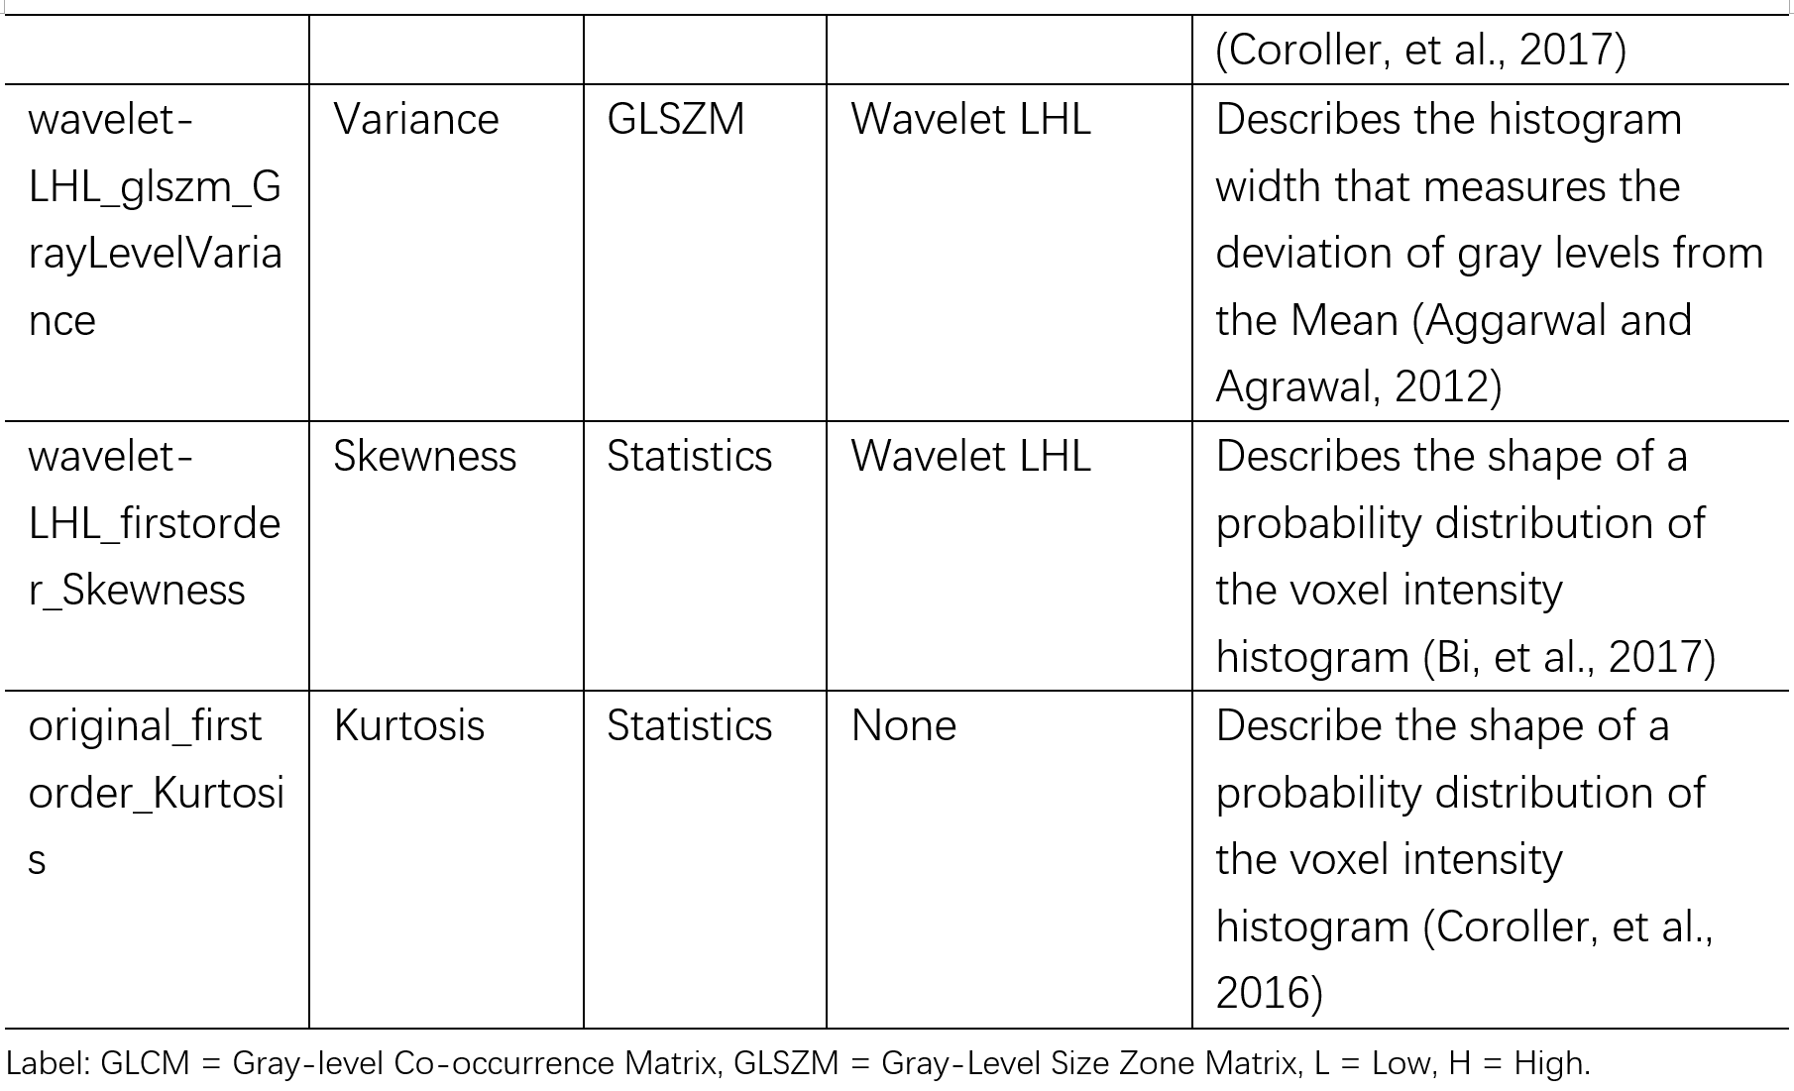

Slide 13
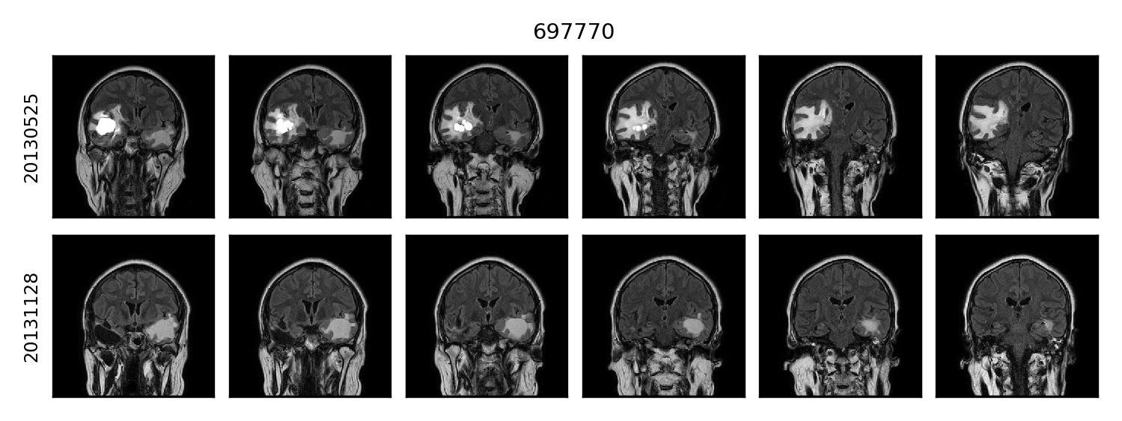
Alarm: Positions are not matched.
1 different-outcome case
(unit: mm^3) | Before | After
697770_RIGHT | 65934 | <2000
697770_LEFT | 7452 | 22572

Slide 14
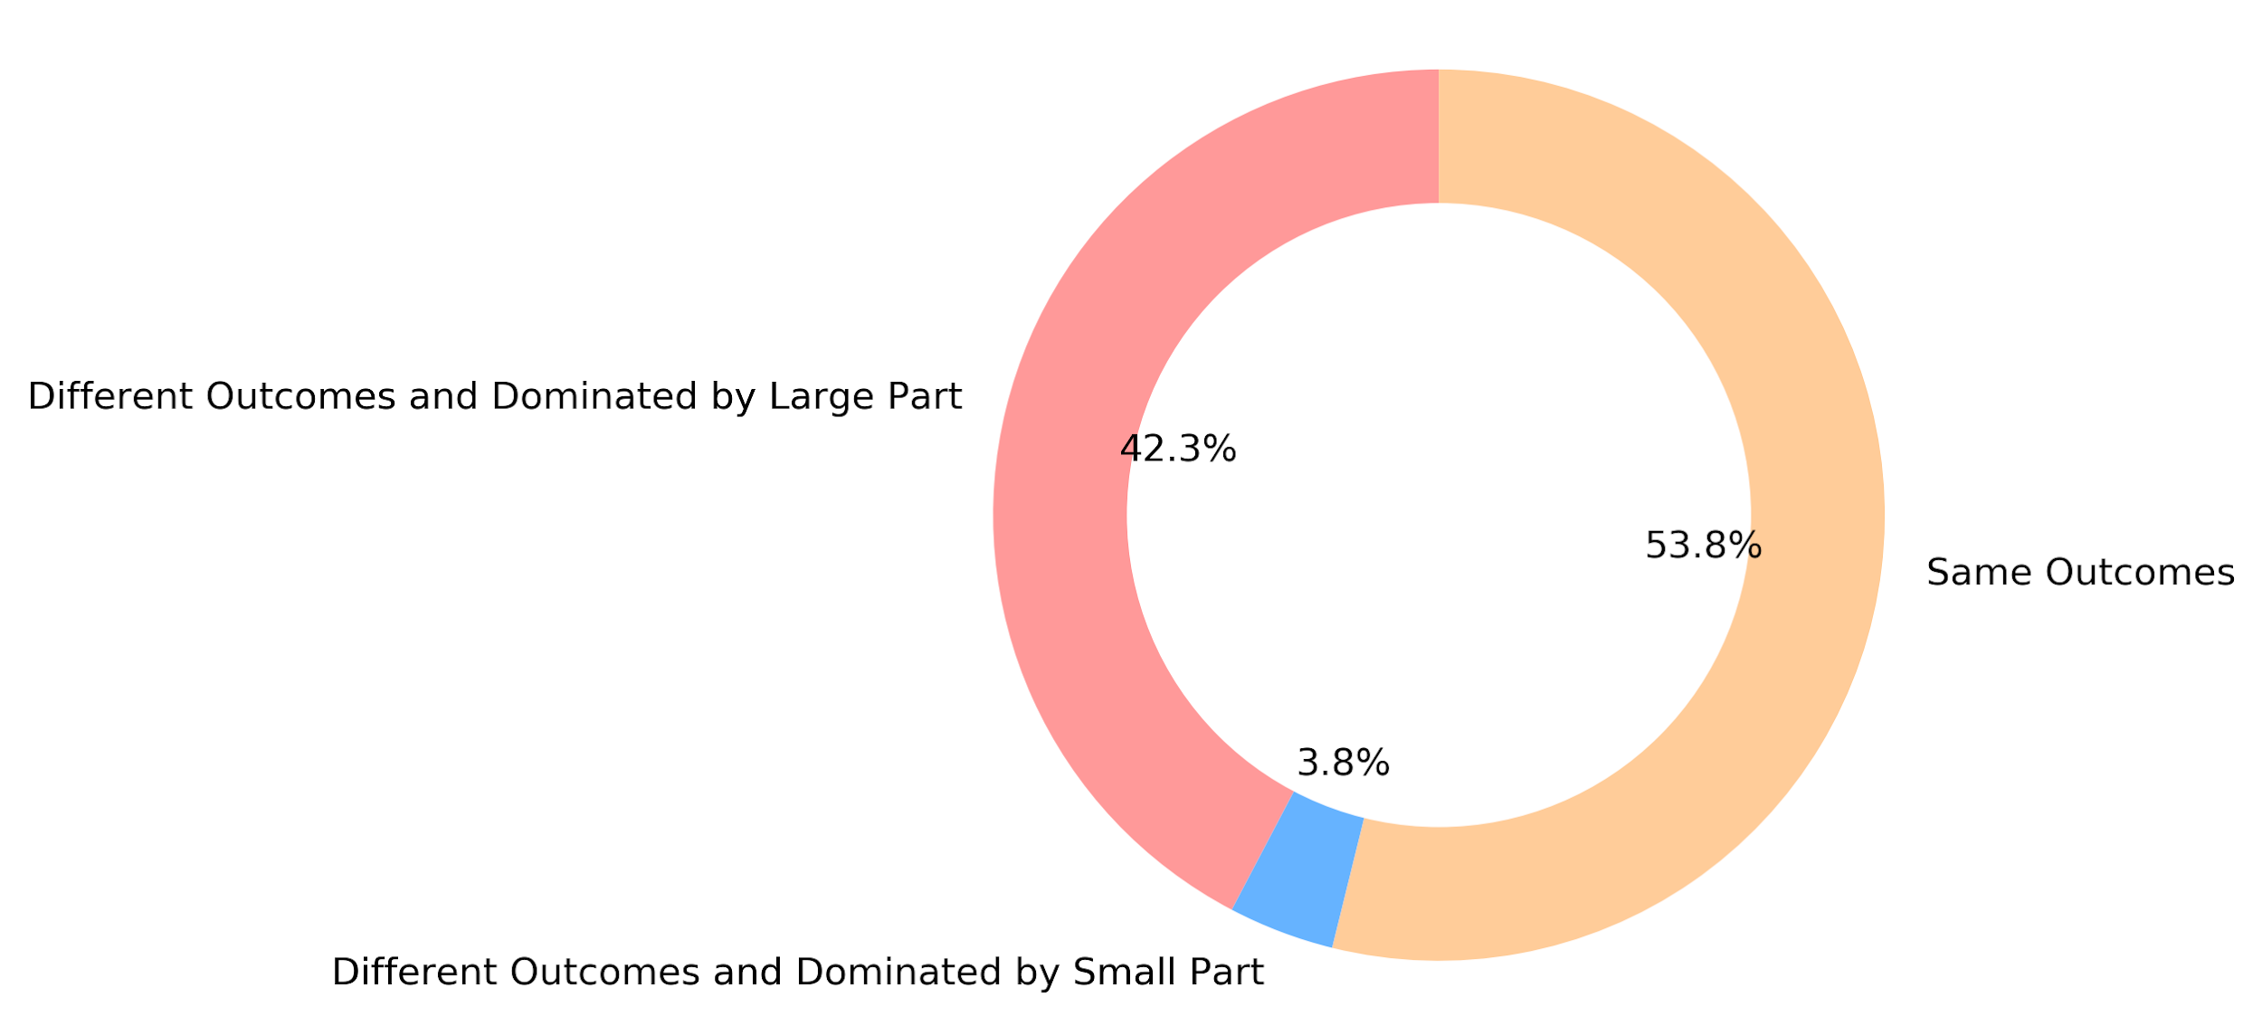
Result 2
26 samples whose both unilateral cerebral edema volumes before therapy are larger than 2000 mm³
Prediction on whole is representative. (1 outlier)

Slide 15
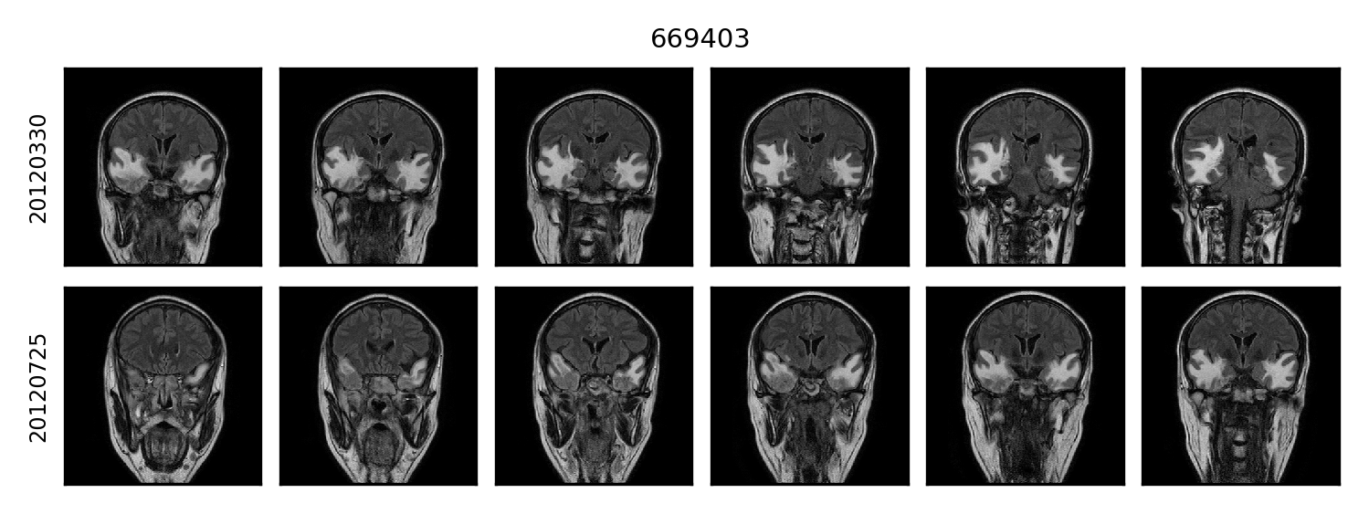
Alarm: Positions are not matched.
(unit: mm^3) | Before | After | Effectiveness
669403_RIGHT | 50517 | 37125 | -0.2651
669403_LEFT | 27729 | 22221 | -0.19864
Whole | 78246 | 59346 | -0.24155
1 outlier case

Slide 16
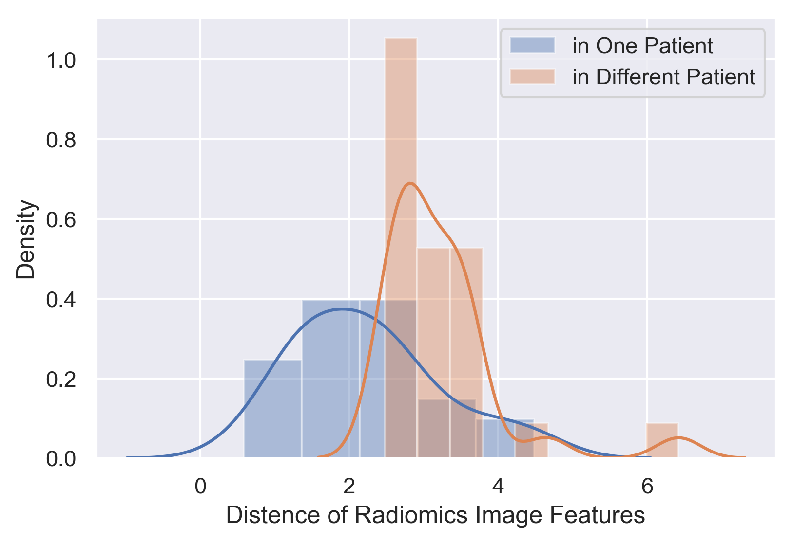
Prediction on whole is representative. (insiders are similar)
The distance of two unilateral cerebral edema images from one patient is significantly smaller than the distance of unilateral cerebral edema images in different patients. p-value= 0.0003

Slide 17
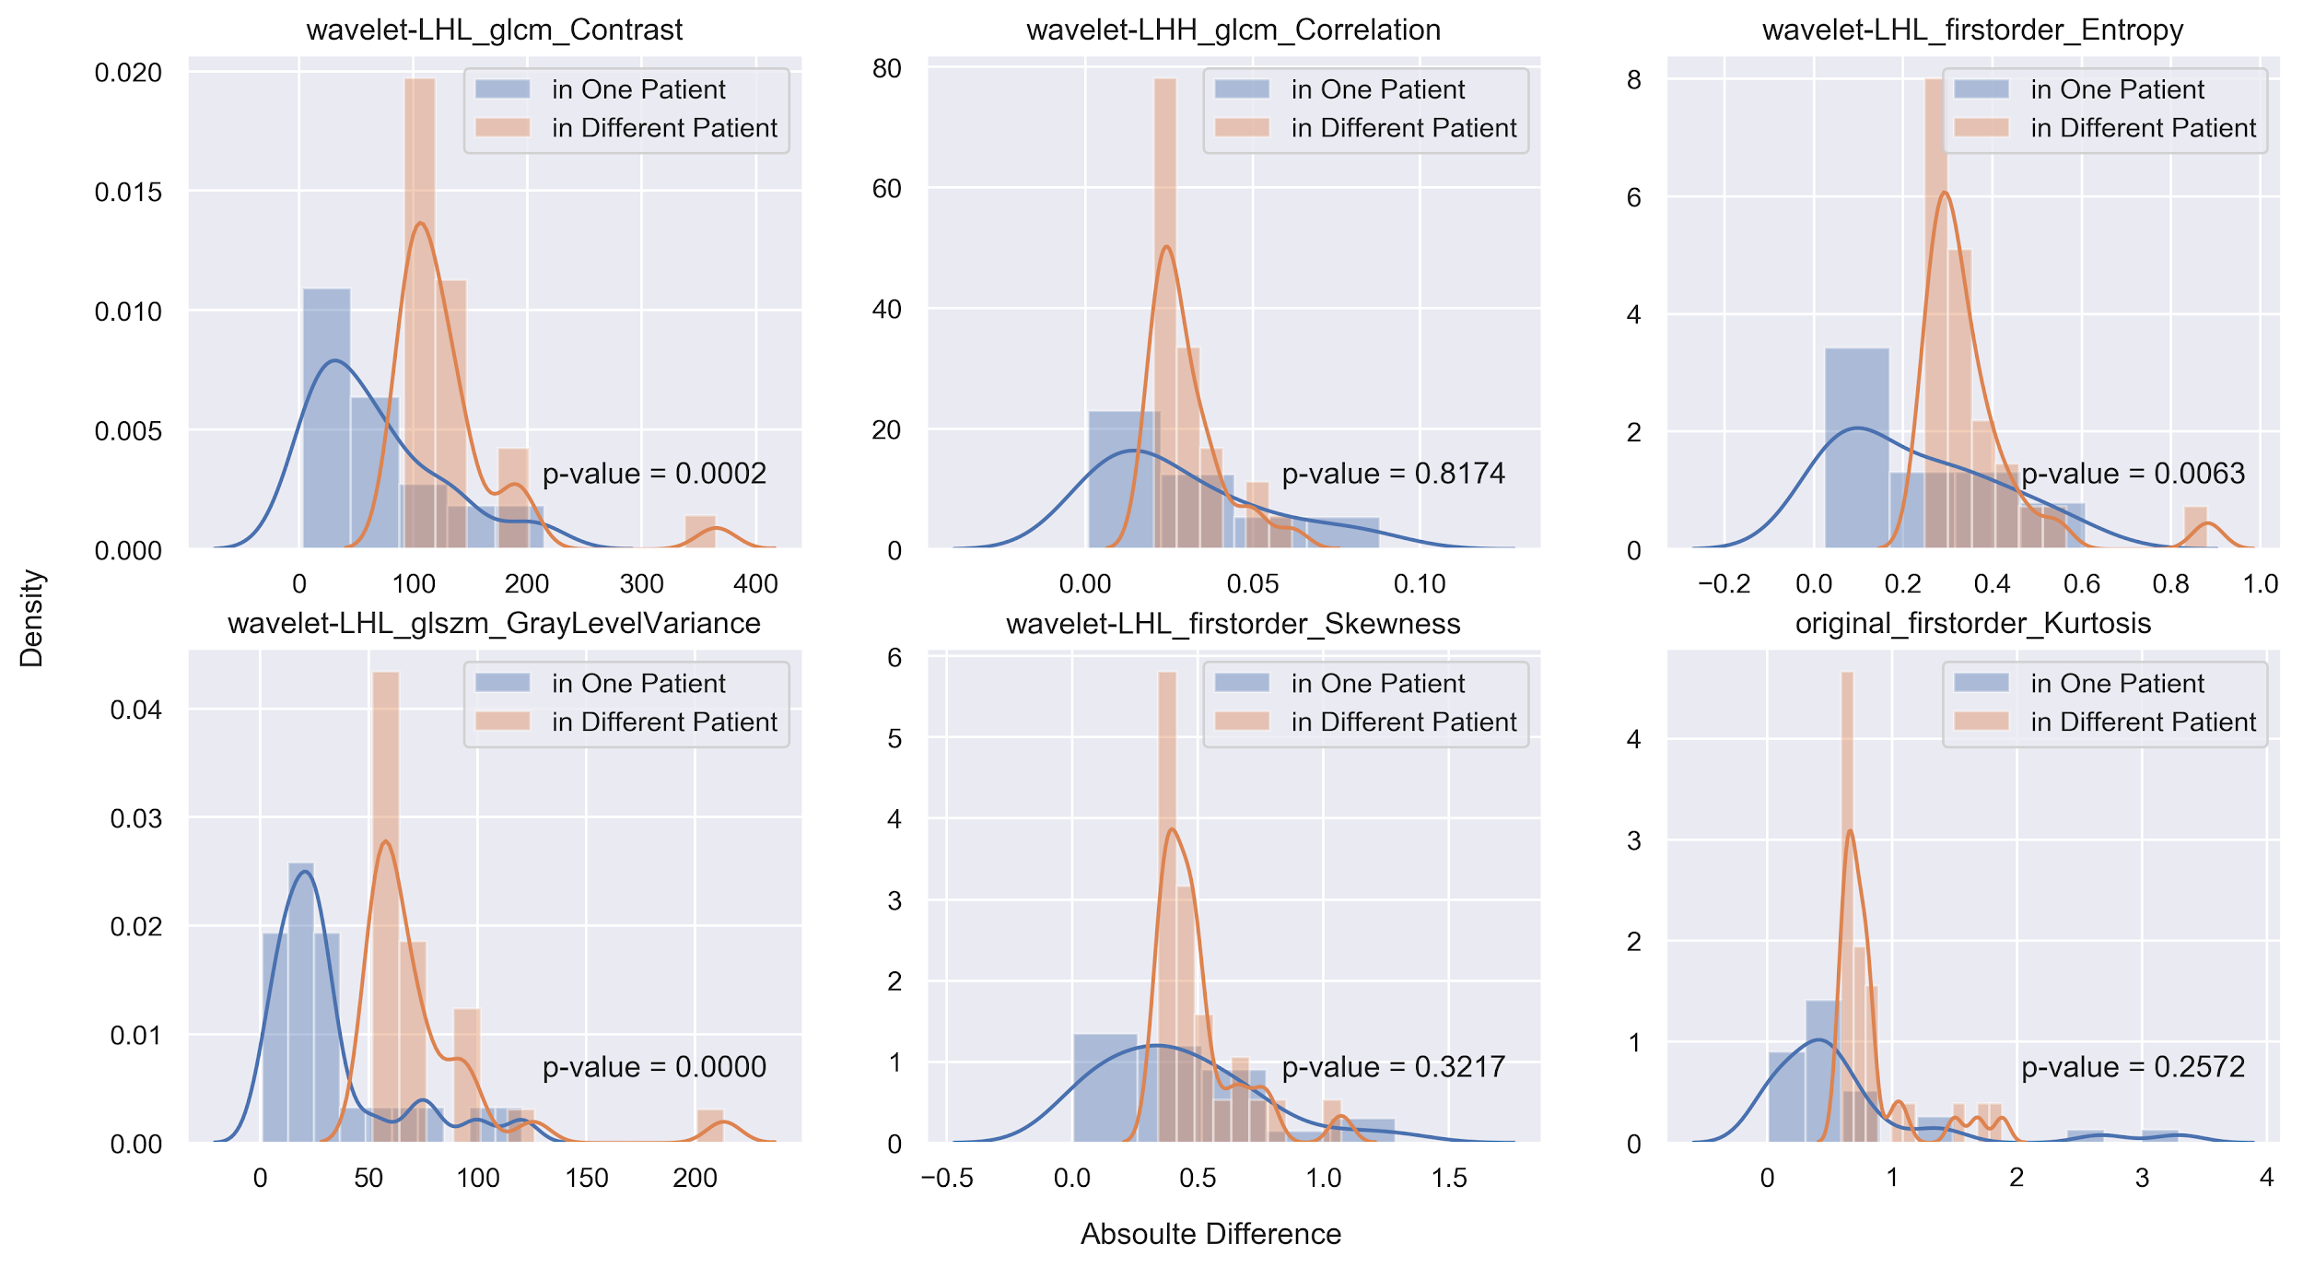

Slide 18
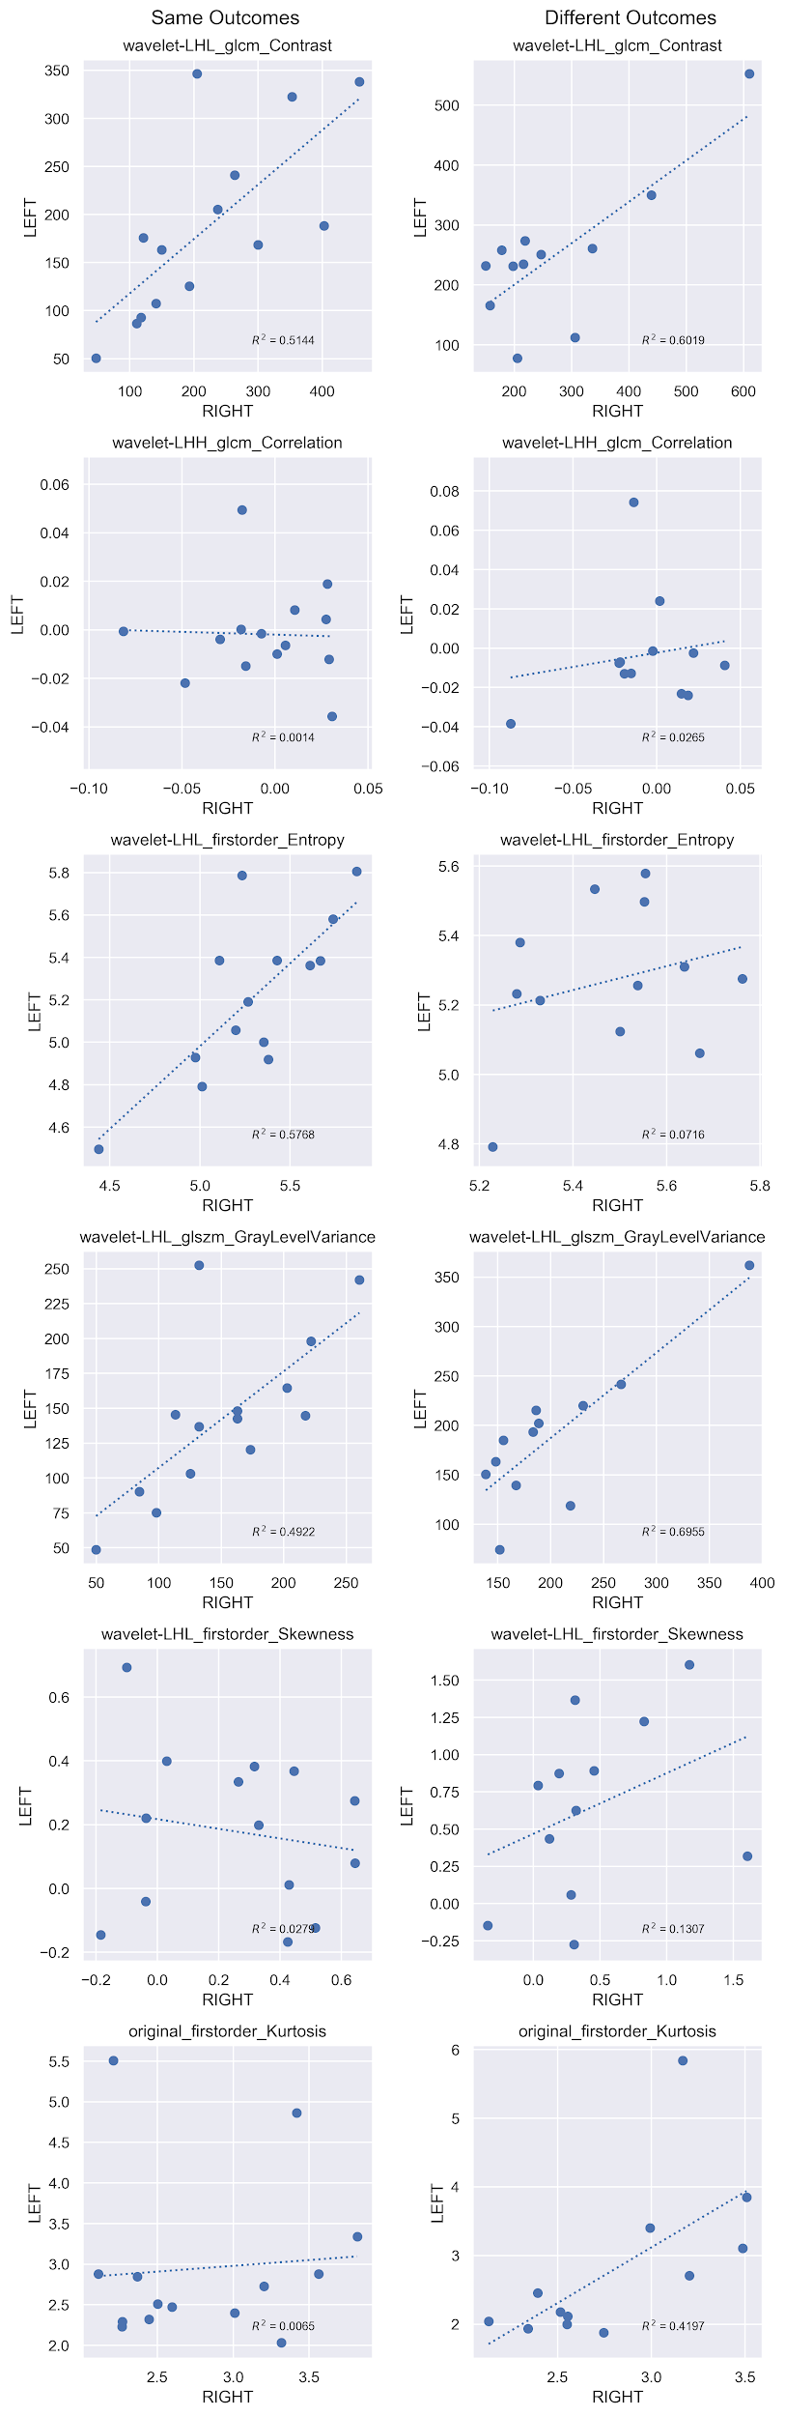
Image features may relate to whether both parts of the bilateral have the same outcome.

Slide 19
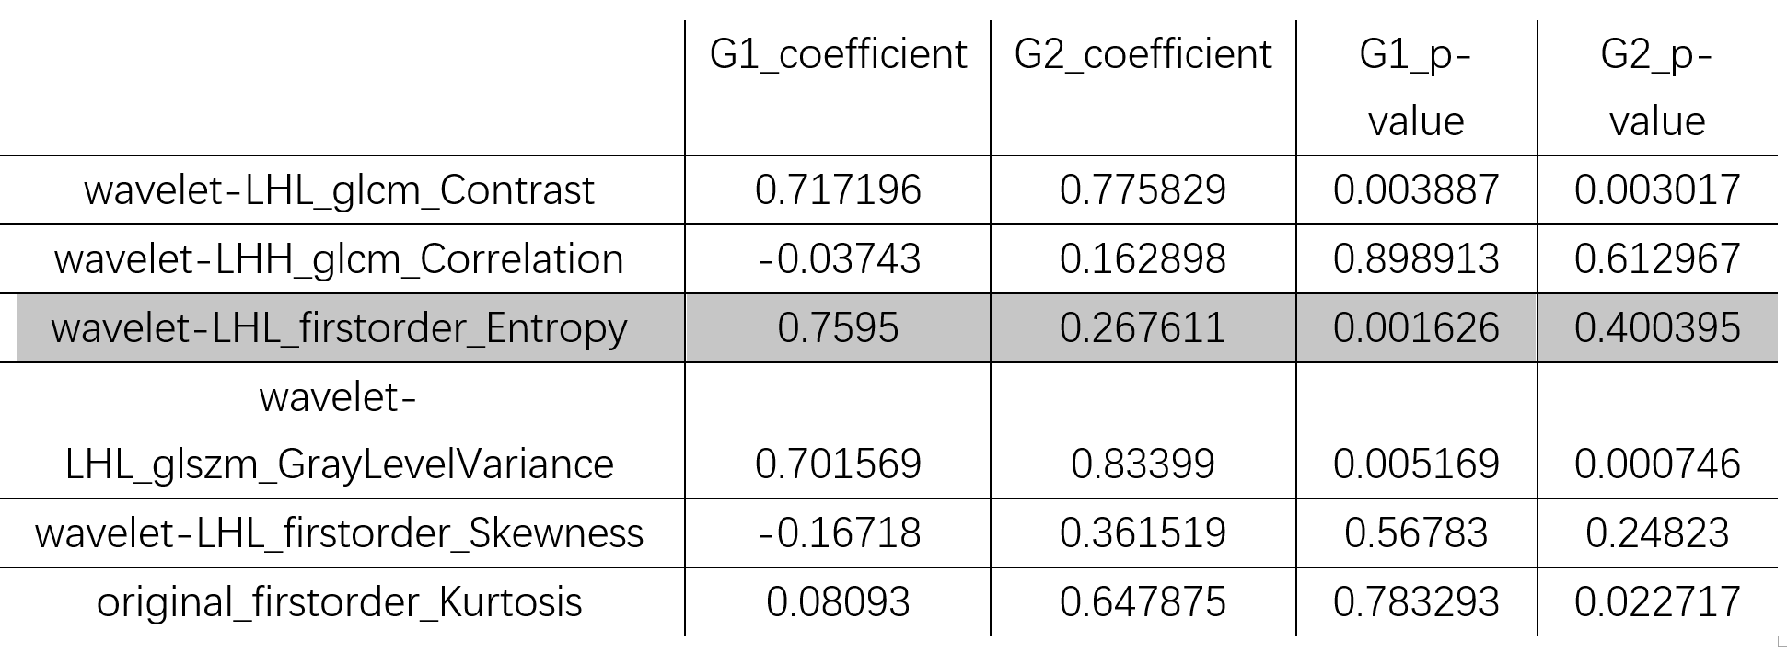
The coefficient of wavelet-LHL_firstorder_Entropy in G1 is 0.76, while it in G2 is 0.26, which may imply this feature (the measurement of the unorderness of texture) is related to whether both parts of the bilateral have the same outcome.

Slide 20
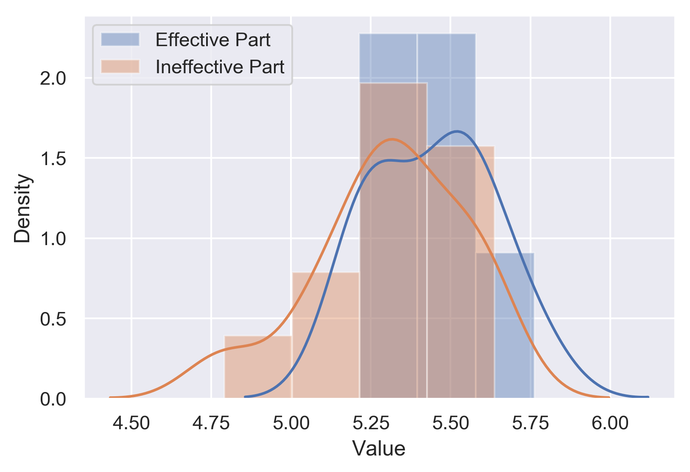
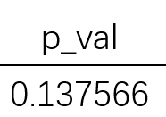
Besides, 12 bilateral samples whose outcomes are different are selected. The outcomes match our previous outcome that the effective group’s wavelet-LHL_firstorder_Entropy is larger than the ineffective group’s.

Slide 21
Conclusion
A prediction model of the therapy effectiveness was created on 6 MRI image features and 2 clinical physiological features, achieving auc of 0.76.
The prediction on whole image is representative, since only 1 sample’s larger edema outcome differs from the whole outcome and the features from a patient’s different parts are similar.
The volume ratio and Wavelet-LHL_firstorder_Entropy may relate to the different outcome of bilateral ’s two parts

Slide 22
Reference
Aggarwal, N. and Agrawal, R.K. (2012) First and Second Order Statistics Features for Classification of Magnetic Resonance Brain Images, Journal of Signal & Information Processing, 3, 146-153. Bi, W., et al. (2017) Radiographic Prediction of Meningioma Grade and Genomic Profile, Journal of Neurological Surgery Part B Skull Base, 78, S1-S156. Coroller, T.P., et al. (2017) Radiomic-Based Pathological Response Prediction from Primary Tumors and Lymph Nodes in NSCLC, Journal of Thoracic Oncology Official Publication of the International Association for the Study of Lung Cancer, 12, 467. Coroller, T.P., et al. (2016) Radiomic phenotype features predict pathological response in non-small cell lung cancer, Radiotherapy & Oncology Journal of the European Society for Therapeutic Radiology & Oncology, 119, 480-486. Eamoraphan, C. (2003) Content-based image retrieval by spatial similarity using euclidean distance from centroid of common objects. Li, J. and Lu, B.L. (2009) An adaptive image Euclidean distance. Elsevier Science Inc. Shabrina, K. (2011) ANALYSIS USING DISTANCE MEASURING EUCLIDEAN DISTANCE SIMILARITY IMAGE AS THE BASIS OF IRIS EYE.

Slide 23
Thanks

